Slide 1




River Information Services
Presentation kindly provided by Ministry of Transport for the purpose of 2nd Master Class IWT, session 3.
Jarl Schoemaker (NEA)
Brasilia (Brasil), 29 November 2010

Slide 2
WHAT’S RIS??
River Information Services are a comprehensive set of services for navigation on the inland waterway network, which are agreed internationally:
PIANC guidelines
CCNR guidelines
EU directive RIS (05/44)
Information Services provide information to business processes; RIS provides information to inland shipping business processes, ranging from lock management, traffic management, navigation, transport logistics to harbor dues, law enforcement and statistics.

Slide 3
RIS, divided into 8 main categories
FIS, Fairway Information Services
TI, Traffic Information services
TM, Traffic Management services
CAS, Calamity Abatement Services
ITL, Information for Transport Logistics
ILE, Information for Law Enforcement
ST, Statistics
WCHD, Waterway Charges and Harbour Dues
All categories together contain about 75 distinct services

Slide 4
1. Introduction: AIS in RIS
Actoren
Diensten
Software
Overige services :
Informatie t.b.v. Handhaving (ILE)
Statistiek (ST)
Heffingen& havengelden (CHD)
Calamiteiten
Info ondersteuning (CAS)
Lading
Haven
Terminal
Information for Transport Logistics
(ITL):
Lading management
Intermodaal terminal management
Information for Transport Logistics (ITL):
Reisplanning
Terminal management
Schip
Traffic Information & Traffic
Management (TI&TM):
Strat & tact verkeersbeeld
Sluis & brug management
Algemene navigatie ondersteuning
Brug
Sluis
Fairway Information Services (FIS):
Elektr. Kaarten, bedientijden,
NTS, bedientijden bruggen, meteo
4
Notes:
4

Slide 5
EU RIS mandatory implementation
For waterways class IV and above:
Fixed electronic waterway data
Inland ENC’s (electronic navigational charts)
Notices to skippers according to standard
When an authority requires a report the authority has to ensure it can receive this electronically according to ERI standards
When a technical annex to the RIS directive is published it has to be applied by the EU member states within 30 months after publication

Slide 6
RIS standards in the EU
Publishes and in force
  Implementation guidelines 414/2007, 13-3-2007
  Notices to Skippers 415/2007, 13-3-2007
  Tracking and Tracing 416/2007, 22-3-2007
  Electronic reporting 164/2010, 6-3-2010
For acceptance in RIS Committee:
  Inland ECDIS
  Hull databases
RIS directive has to be implemented in national law within 36 months after publication (september 2005)
Implentation technical annexes 30 months after publication

Slide 7
RIS examples
Electronic navigational charts (ENC’s in short, based on S57), used on board of ships using Ecdis (Electronic Chart display). Distribution of ENC’s is part of FIS
Fairway information Services (FIS), covers distribution of not only ENC’s but all fairway related information
Tracking and tracing based on AIS transponder technology
Following dangerous goods based on Electronic Reporting.

Slide 8
1: Electronic Navigational Charts
Navigation, ENC’s seen in the wheelhouse

Slide 9
ENC’s
Electronic Chart display (ECDIS
Actual water depths,
safe sailing lane (supplied by FIS)
Infrastructure information
Weather information

Slide 10
TTI
Radar
Image
in ECDIS

Slide 11
TTI
AIS transponder
ID added
Traffic Image
on board

Slide 12
2: Fairway Information Services
Development of a “single window” concept for distribution of fairway information

Slide 13
FIS (Fairway Information Service)
Realization FIS = single window for all infrastructure information:
    Notices to Skippers information
    Inland ENC’s
    Operating hours locks and bridges information
    Planning of maintenance information
    Legislation
    For all waterways in the Netherlands

Slide 14
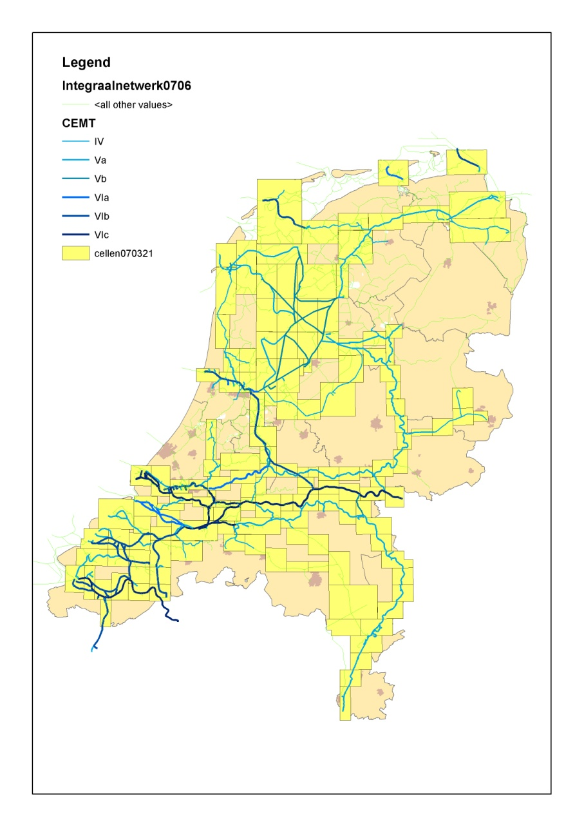
ENC coverage

Slide 15
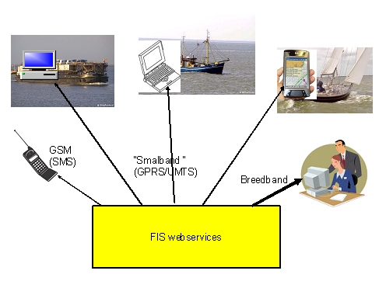
Distribution FIS

Slide 16
FIS as single window

Slide 17
ENC as basis
Notices to Skippers are linked to a GPS location and can be shown in an Electronic Chart
All relevant Notices and opening hours are linked to the actual planned route of the vessel
Planned service at locks and bridges can be shown in the map too
Radartracks and AIS data can be shown on ENC

Slide 18
3: Tracking and tracing with AIS
based on EU Inland AIS standard

Slide 19
AIS: Inland AIS in NL
For all inland ship longer that 20 meters
For all professional ships (excluding navy, but including patrol vessels)
Future: Class B transponders for larger recreational vessels

Slide 20
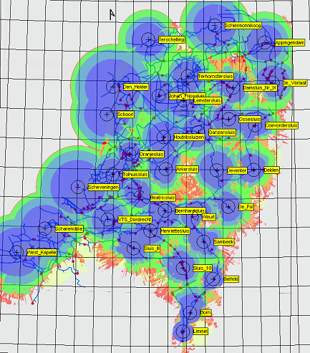
AIS shore based systemse schets
Full coverage of inland waterways
Integrated with coastal chain
Integrated with large port chains

Slide 21
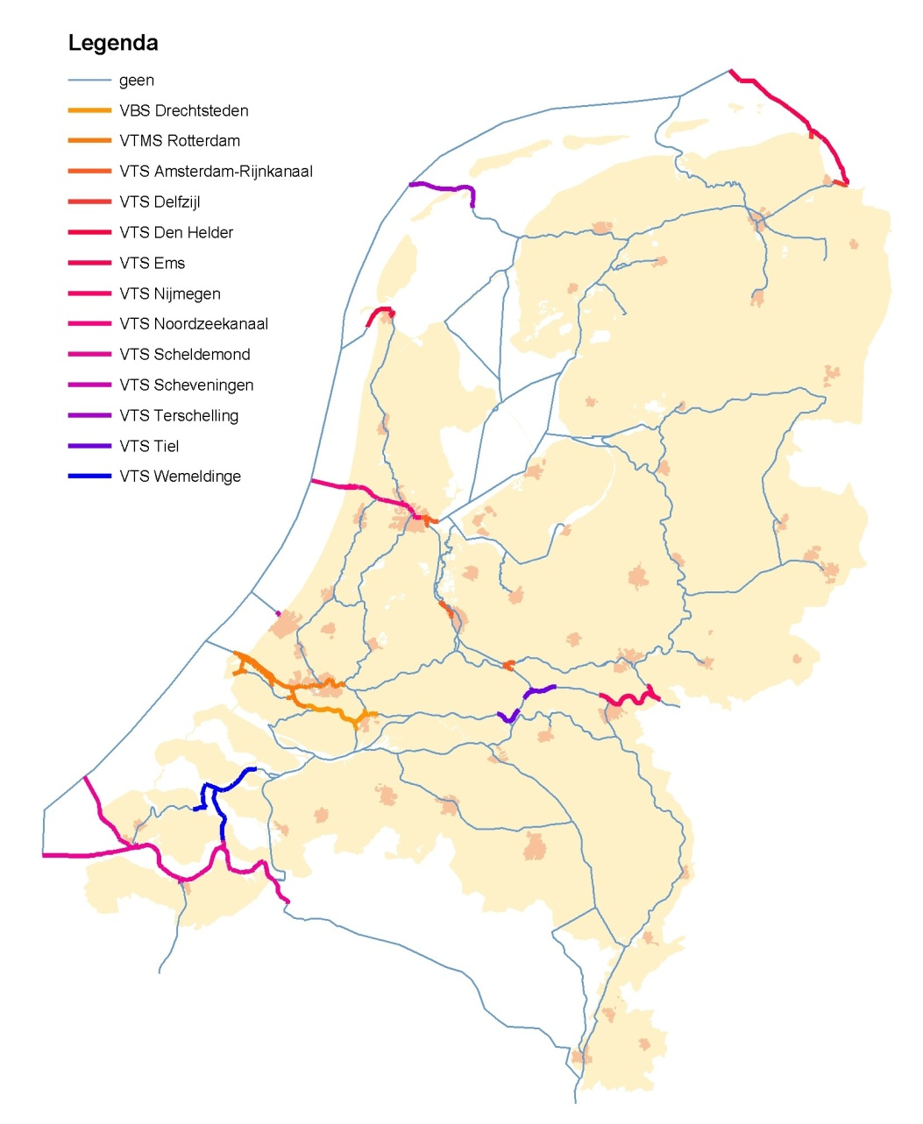
AIS means
Better reliability for radar chain images in VTS-centers
Monitoring throughout the country, support for incident management
Better planning of traffic, better lock and bridge management
Better utilization of fairway network and objects (locks and bridges) within the network

Slide 22
2. RIS Pilots based on AIS
Mittelweser
Hoornbridge
Port of Rotterdam
Corridor 895

Slide 23
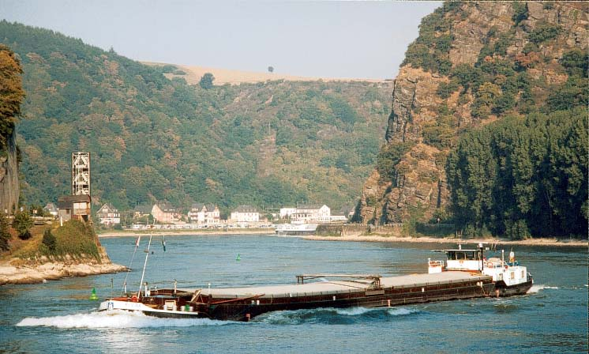
Example application of AIS in Germany: Mittelweser

Slide 24
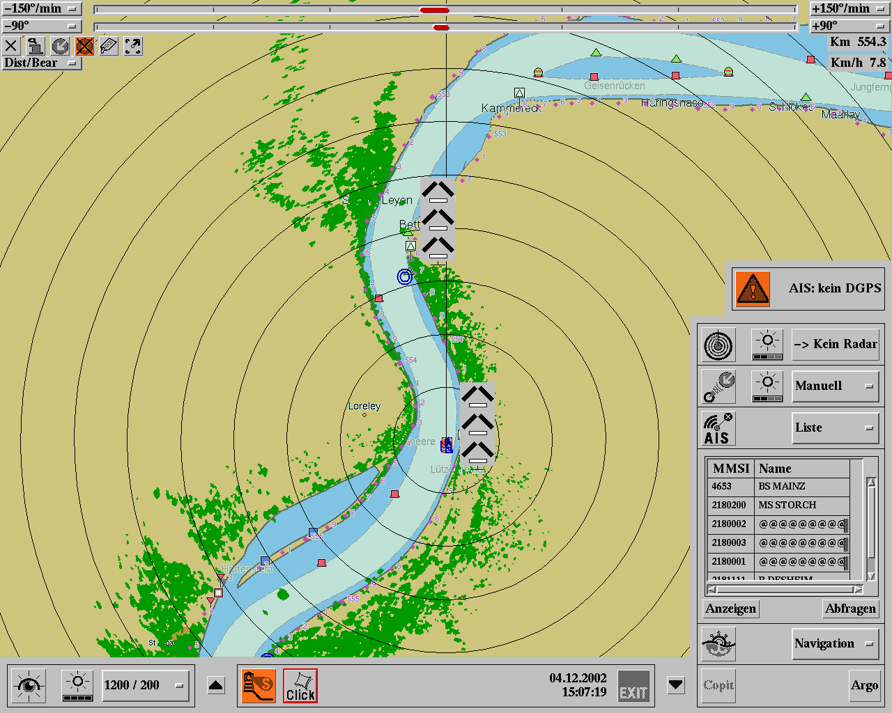
Mittelweser
BS Mainz 18 km/h
Bremen
BS Mainz
BS Leo Sympher
Minden

Slide 25
Mittelweser
Narrow River
Large vessels
Single Lane traffic
Arrangement for passing and overtaking

Slide 26
Hoornbridge

Slide 27
Hoornbridge
Planning of bridge opening taking into account
  Demand of navigation
  Demand of streetcars (trams), cars and others traffic
Results:
  Through AIS reliable navigation planning
  Streetcars are however unreliable with respect to planning
Intermediate result:
  Bridge capacity for both navigation and road traffic has been enlarged because of AIS:
    Planning in advance, communication of planning towards ships
    Ships arrive just in time and pass without stopping or manoeuvring
    Bridge openings are shorter

Slide 28
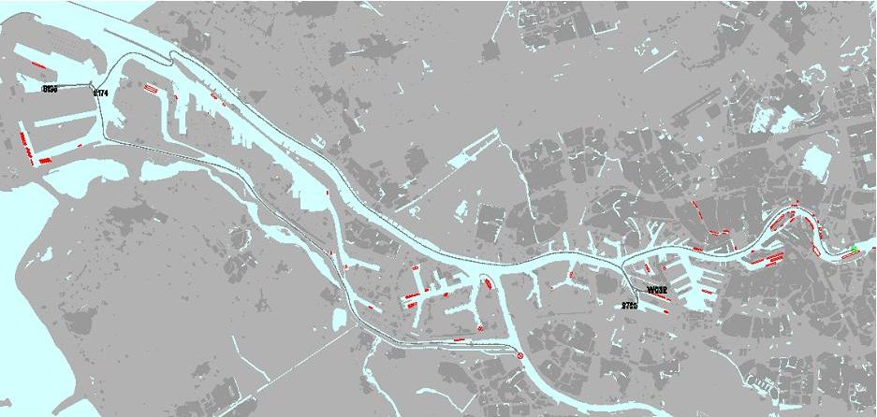
Port of Rotterdam

Slide 29
Port of Rotterdam
Tracking of vessels for berth planning and prediction of required berth capacity in port extension project Maasvlakte 2
75 vessels tracked during 6 months
Huge amount of information
Reliable prediction of berth demands

Slide 30
Corridor 895
Additional programme for installation of 895 inland AIS transponders on vessels on the route Rotterdam – Germany
Objectives:
  Smooth introduction in inland navigation community
  Testing of large amounts of AIS transponders in confined areas
Results
  Big support of inland navigation
  List of 895 vessels was filled within 3 days
  Skippers are excited about the added value on the wheelhouse
  Skippers react extremely negative on the side effects generated by the Internet: Marinetraffic.com / LiveAIS

Slide 31
3. Full scale implementation
To support the further introduction Germany and the Netherlands have started subsidy programmes to support the installation of inland AIS on board of 9800 vessels
Subsidy programmes run between 2009 and 2012
Intended for all vessels with a length of 20m or more and for all commercial vessels
Intended for any vessel on our waterways regardless of the flag
Requirement: vessel must be proven user of german and dutch waterways

Slide 32
4. Future Benefits
Use of AIS for River Information Services:
  Safety and Traffic Management
    Enhanced traffic information in the wheelhouse
    Better Traffic Image at VTS stations and locks
    Use for long term planning at locks and movable bridges
    Immediate and accurate traffic overview at accidents locations
    Savings for personnel costs at VTS centres
  Transport management
    Better partner in logistic chains
    Customer can always follow its cargo
    Logistic performance of navigation will improve by supplying more reliable ETA’s

Slide 33
Lessons learned during introduction
Application of new technology in inland navigation is troublesome:
  Inland navigation community is divided in its opinion
    Large operators are strong supporters
    Family operated vessels are extremely reluctant
  Respecting privacy supports the successful introduction
  Financial support helps as well
  Getting used to new technology is a time consuming process
  Start making it a private-public partnership as soon as possible

Slide 34
4: Electronic reporting
and
following dangerous goods

Slide 35
Overview
Introduction of electronic Reporting
Electronic Reporting process
Practice with ER in Western Europe
Pilot setup

Slide 36
What is electronic reporting
Electronic reporting is:
to report vessel, voyage and cargo/passenger details electronically to a water management system by using harmonised, standardised messages and codes

Slide 37



Reference data and messages
Standardised messages
BERMAN Pre-arrival notification / General Declaration,
IMO FAL Form 1
CUSCAR Cargo Declaration, ICS Standard Manifest /
IMO FAL Form 2
INVRPT Ship’s Stores Declaration, IMO FAL Form 3
PXLST Crew List, IMO FAL Form 5
PXLST Passenger List, IMO FAL Form 6
IFTDGN Dangerous Goods Manifest, IMO FAL Form 7

Slide 38
Reference data and messages
International reference data
Vessel and convoy type (UN recommendation 28)
Harmonised System Code (HS) (GHS)
Dangerous Goods (ADNR)
Container size and type (ISO 6364)
Packing type

Slide 39
Objectives of Electronic Reporting
To facilitate the exchange of information
To ensure that information can be provided and used by all parties having a legal right to obtain such information.
To facilitate the exchange of information between authorities
To streamline inland shipping procedures
To simplify procedures and processes
To provide clarity and enable risk assessment

Slide 40
Advantages
The exchange of data is simplified through the use of standardised codes for cargo details, port names and vessel types
Limit of VHF use:
  only a short identification is required on the arrival at or passage of a lock of traffic centre
Reduction of administration on board and ashore

Slide 41
Advantages
privacy/security: no “listening in” on VHF comm.
less paperwork:
  no longer required to send faxes to a lock or traffic centre/reporting point
  no longer required to fill out reports on paper for statistics , customs and immigrations
conversion of messages (import/export facilities in software rather than manual) with other programs e.g. stowage plan, stability calculation etc

Slide 42
Electronic reporting process
Example:
Voyage from Rotterdam (Netherlands)
to
Duisburg (Germany)

Slide 43
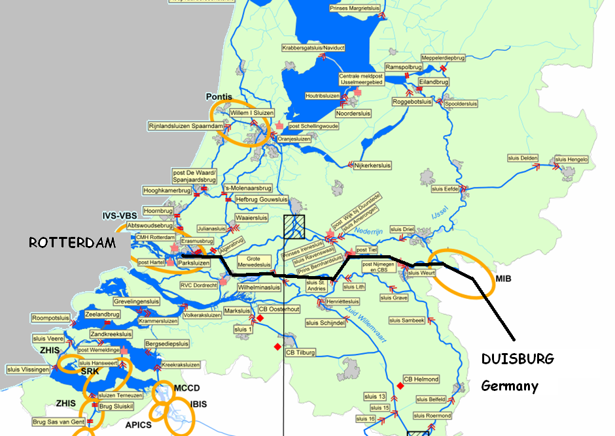
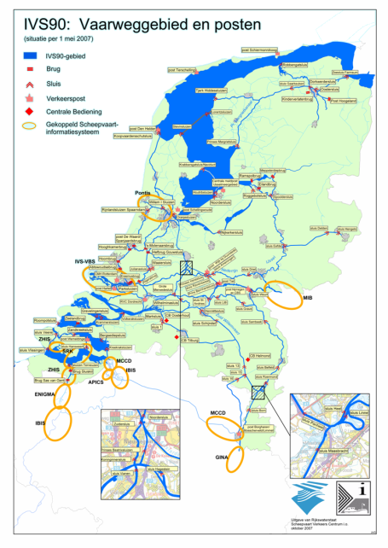

Slide 44
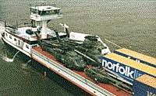
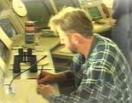
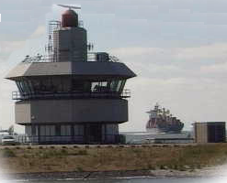

Inland traffic – (Electronic) Reporting
On departure A skipper has to announce his intended journey and dangerous cargo onboard to a local (port) authorities and or Traffic Control Centres.
Inland vessel:
Announcing
journey / passage
Rotterdam
(Netherlands)
Mariphone
(name & id)
Inland vessel:
Announcing
arrival
Traffic Control
Centre
Electronic
reporting
Mariphone
border
Inland vessel
Announcing
departure
Duisburg
(Germany)
AND Again
Traffic Control
Centre
Inland vessel:
Announcing
journey / passage

Slide 45
Necessary Components
A program to send the announcement electronically to the competent authority eg. BICS / ERI-net
Messagebrooker (mailbox system) to route and convert the messages
A program to receive and show the digital information (equiv. IVS90)

Slide 46
Overview of the necessary components

Slide 47
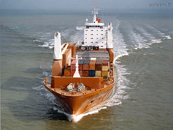
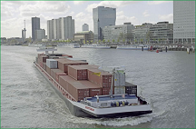
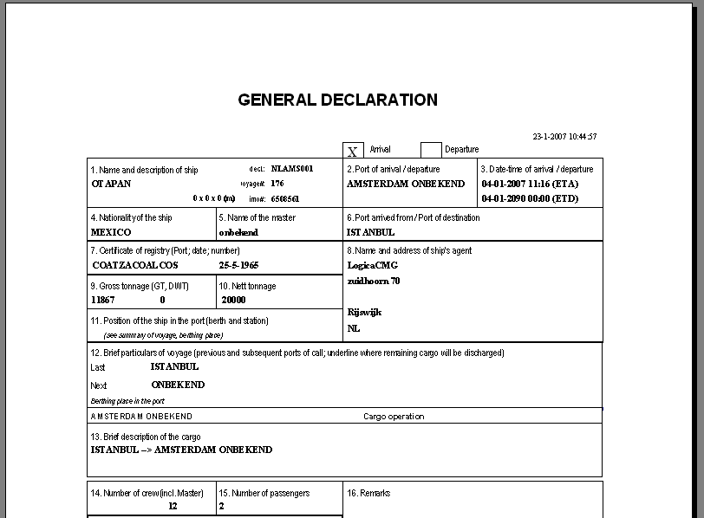
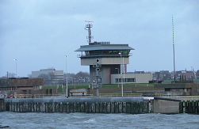
ERI-net main functionalities
1 Central Application with a (protected) Database
Each user has own (private) area in the central DB
Data exchange (users <=> authorities) based on standardised EDI messages
Reporting functions using single window concept. Amsterdam Single Window example:
  Port Authority
  Customs
  Immigration

Slide 48
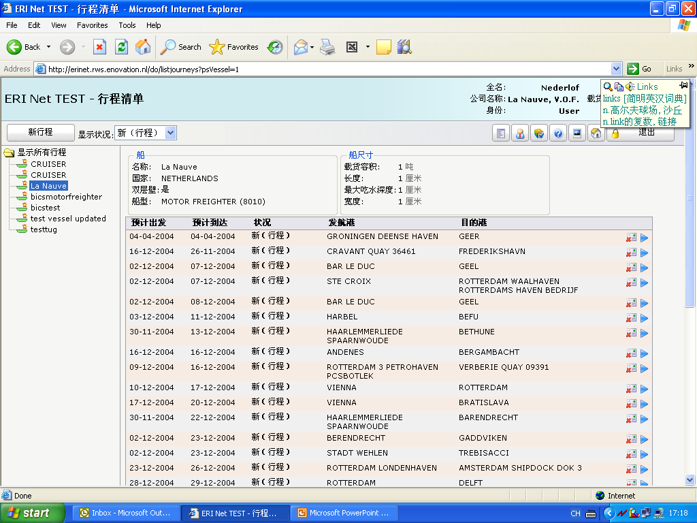
Example of ERINET voyage overview

Slide 49
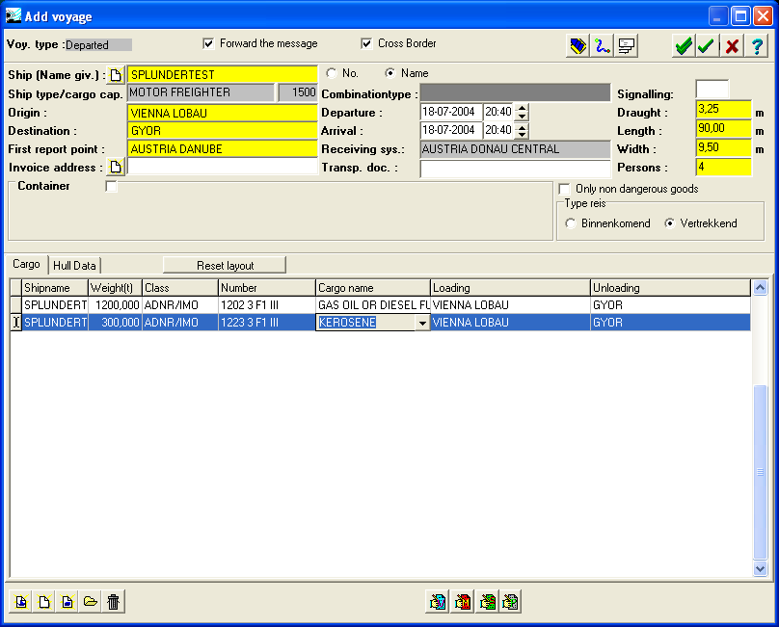
Example of BICS reporting program

Slide 50
Current developments ER in NL
Mandatory electronic. reporting 1-1-2010 Rhine states, 2011 container nr + stowage locations
Extended functionality for container ships, complex cargo messages with stowage planning data
Further enhancement of legal framework,
NL, EU and CCNR regulations
Quality improvement program for current ER systems (availability 99.9%, international connectivity)
Planned replacement of current technology (IVS90) in 2013

Slide 51
Pilot/demo dangerous goods monitoring
Skippers report voyage and dangerous cargo to local fairway authority
Messages stored in regional data center
Local authorities can receive/retrieve this data for operational monitoring of inland vessels / traffic in their region
Regional data collected centrally for non-operational monitoring and statistics
Technology can be based on existing RIS components (NL) and some new / customised components

