Slide 1
The role of the Internal Control Body in Fighting Corruption
ROBERTO CÉSAR DE OLIVEIRA VIÉGAS Head of the Regional Office of the CGU at the Federal State of Minas Gerais 19/09/2014

Slide 2
Roberto César de Oliveira Viégas
Head of the Regional Office of the CGU at the Federal State of Minas Gerais
Finance and Control Analyst
Degree in Economics
Master in Economics
Post-Graduated in Economic and Political Context

Slide 3
Summary
CGU – Basic Functions
CGU Field Areas
The 4 Lines of Action of the Internal Control
Inspection
How to Fight Against Corruption
How may the Internal Control act to Fight Against Corruption
- Interinstitutional Coordination, Legal Framework, Information Systems, Policies Improvement
Study Cases
3

Slide 4
CGU – Basic Functions
CGU is the institution in charge of the Internal Control of the Federal Government, but is also responsible, within the Federal Executive Branch, for the disciplinary function, for the coordination of an Ombudsman System and for preventing and fighting against corruption.
3

Slide 5
Simplified Organogram – CGU
Minister of State, Head of the Office of the Comptroller General
Vice-Ministry / Executive Secretatiat
Federal Internal Control Secretariat
Transparency and Corruption Prevention Secretariat
National Ombudsman’s Office
National Disciplinary Board
26 Regional Offices at States
5

Slide 6
The 4 Lines of Action of the Internal Control:
Assessment of the Execution of Public Programs
Evaluation of the Managerial Results
Training and Orientation
Inspections (Investigative Actions)
6

Slide 7
Inspection (Investigative Actions) include:
Special Auditing of bodies and entities where CGU has previously identified serious problems;
Investigation of citizen complaints or press publications;
External Requests – inspections following requests from Public Prosecutors, Federal Police, Parliament members and other authorities;
Special shared engagements with the Federal Police
7

Slide 8
AND HOW TO FIGHT AGAINST CORRUPTION?
PREVENCTIVELY ACTING, TACKLING MAIN RISK FACTORS THAT FAVOUR THE EMERGENCE AND THE DEVELOPMENT OF FRAUD SCHEMES:
A) EXISTENCE OF OPPORTUNITIES
B) CONFLITS OF INTEREST
C) IMPUNITY
8

Slide 9
EXISTENCE OF OPPORTUNITIES
Weak/fragile internal control (accounting or administrative). The administration must constantly improve its controls, where they be logical, technical, corrective, accounting, etc.
Untimely inspections/verifications.
9

Slide 10
CONFLITS OF INTEREST
Follow not only from poor moral values, but also from the sharing of scarce resources of the Public Budget
Negotiation between businessmen and parliamentary members around budgetary amendments
9

Slide 11
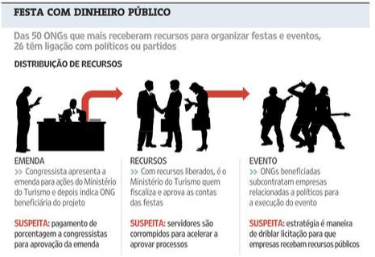
CONFLICTS OF INTEREST
(PARTY WITH PUBLIC FUNDS)
Source: Folha de São Paulo, 19/04/2010
10

Slide 12
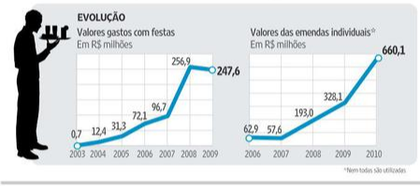
CONFLICTS OF INTEREST: “Farinha pouca meu pirão primeiro”
(grab what you can and let the devil take the hindmost)
Amount spent with festivities
Budget Amendments
Source: Folha de São Paulo, 19/04/2010
11

Slide 13
WHERE MAY THE INTERNAL CONTROL ACT?
The corruption diminishes as the opportunities that lead to their taking place diminish.
Timely and adequate punishment of the corruption acts
Creation of controls/regulations that alienate fraud and corruption acts in private national and international corporations
Assurance that the process of approval and allocation of parliament amendments (to the public budget) obeys transparent and defined rules.
12

Slide 14
HOW MAY THE INTERNAL CONTROL ACT TO FIGHT AGAINST CORRUPTION?
A) REFINEMENT OF THE LEGAL FRAMEWORK
B) CORRETIONS AND IMPROVEMENTS OF PUBLIC PROGRAMS
C) INTERINSTITUTIONAL COOPERATION – PARTNERSHIPS
C.1) PRODUCTION OF EVIDENCE TO INVESTIGATIONS AND PROCEDURES AT THE ADMINISTRATIVE, CIVIL AND CRIMINAL AREAS
D) CREATION, DEVELOPMENT AND SHARING OF INFORMATION SYSTEMS
13

Slide 15
REFINEMENT OF THE LEGAL FRAMEWORK
CGU has been heading significant shifts of the legal framework in recent years to reduce conflicts of interest (Law 12813/2013) and to hold accountable (at the civil and administrative levels) domestic and foreign companies that committed acts against the administration, by means of Law No. 12,846 / 2013 (Clean Company Law). Also worth mentioning the Freedom of Information Act (LAI).
14

Slide 16
INTERINSTITUTIONAL COOPERATION
One of the basic guidelines of CGU activities, adopted since 2003, is to favor the cooperation and the partnership with other public entities accountable for the defense of the State interests and for the enhancement of the public management, respecting the differences and responsibilities of each body.
15

Slide 17
CGU – PARTNERSHIPS – LAW 10683/2003
CGU will submit to the Attorney-General for the Federal Government cases that constitute administrative improbity and all that recommend asset freezing, the compensation to the treasury and other measures in charge of that body, as well as will trigger, whenever necessary, the acting of the Federal Court of Accounts, of the Internal Revenue Service, of other bodies of the Internal Control System of the Federal Executive Branch and, whenever signals of criminal responsibility are available, the Department of Federal Police and the Public Prosecutor, including when regarding representations or complaints that may seem manifestly calumnious.
(Extracted from § 3º, art. 18, Law 10683/2003)
16

Slide 18
Cooperation with the Federal Prosecution Office
Classes of Action started by the Prosecution Office, 2004 to 2014 (Rel. CGU)
Civil Investigation: 3.096
Notification of Facts: 1507
Administrative Procedure: 50
Investigative Criminal Procedure: 140
Preparatory Procedure: 1598
Total............................... 6391
Cooperation in Inspection Engagements (Technical Cooperation Protocol 2014)
17

Slide 19
Partnership with the Federal Police
Joint Special Operations;
Technical collaboration on Police Inquiries and Investigations;
Sharing of information for the purpose of liability of public servants and contractors;
Ensuring the safety of CGU staff when inspections / audits take place.
18

Slide 20
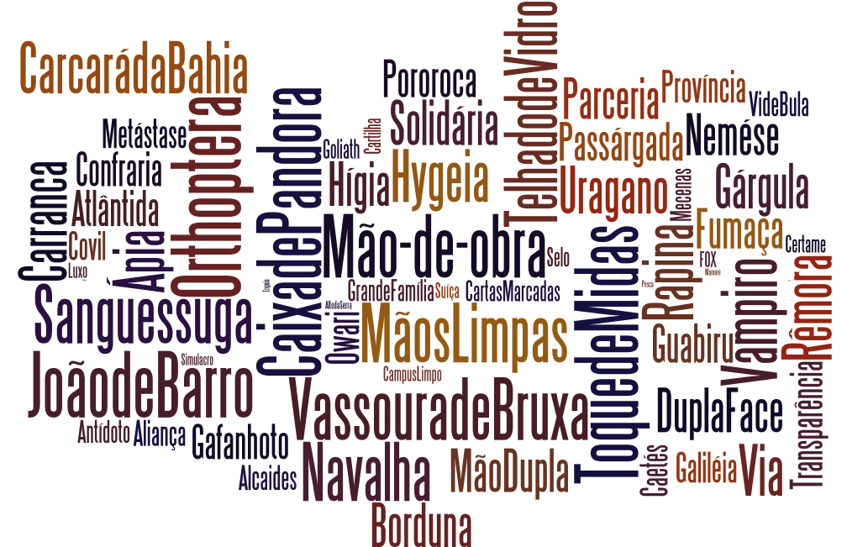
156 Special Operations 2003-2014
1410 arrests – 372 arrests of public servants
US$ 1,1 billion (estimated loss)
19

Slide 21
Concrete cases of joint engagements
38º Municipal Lottery – Brejo de Areia/MA
Esopo Operation
Sufrágio Livre (Free Suffrage), Orthoptera I and II Operations
20

Slide 22
38th Municipal Lottery – Brejo de Areia/MA - Context
Breach of legislation resulting in negative effects on the execution of the audit engagements
Use of technology without overlooking operational issues:
a) Queries to systems and sparse documentation presented revealed that R$ 2.8 millions were spent on reforms of municipal schools
b) Site visit enabled carrying out interviews and preparing reports (key evidences for prosecution)
Search and seizure order provided a snapshot of the municipality situation (documentary and physical)
Strengthening of the Municipal Lottery Program
21

Slide 23
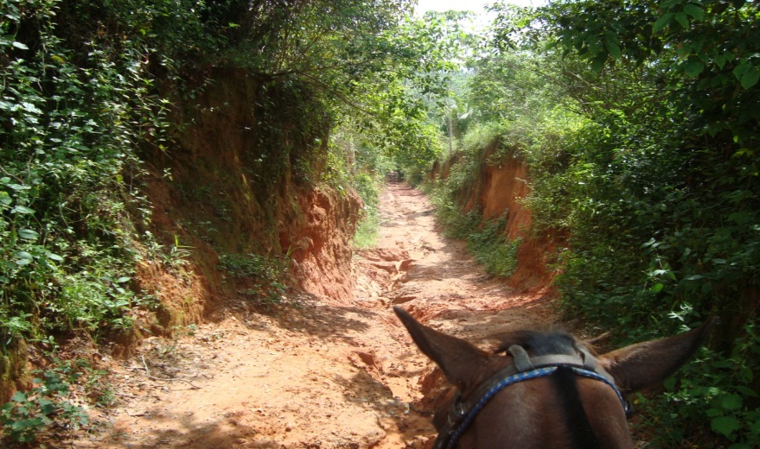
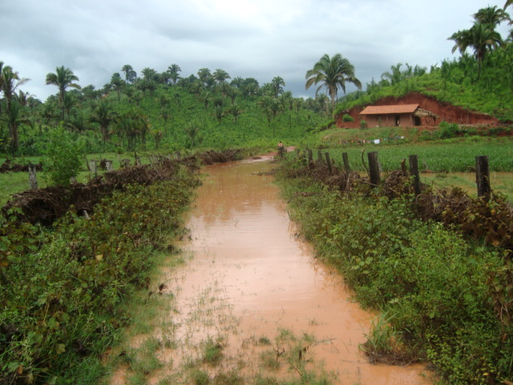
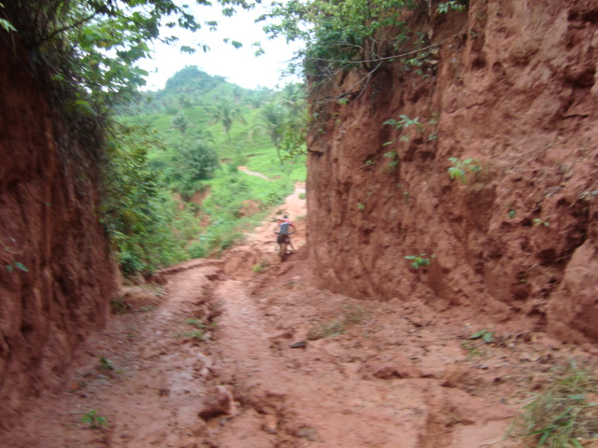
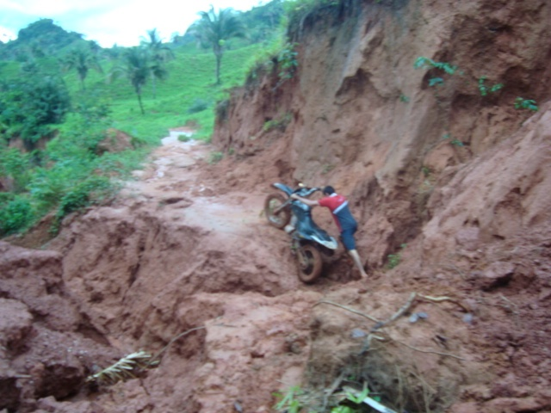
38th Municipal Lottery – Brejo de Areia/MA - Limits
22

Slide 24
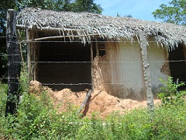
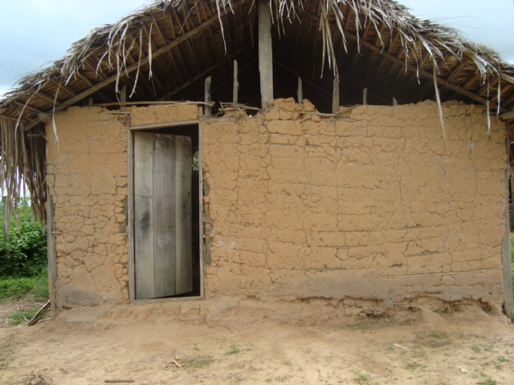
38º Sorteio – Brejo de Areia/MA
Municipal School Centro dos Cloves Municipal School Andiroba
Expenditure with reform Expenditure with reform
2012: R$ 52.548,97 2012: R$ 139.826,15
2011: R$ 122.412,66
24

Slide 25
ESOPO/MG - Context
Originated from an engagement within the Annual Rendering of Accounts
Transfer of funds from an entity of the “S System” (parafiscal system) to an OSCIP (NGO)
CGU inspection deepened by an audit engagement of the PROJOVEM Program (Labour Ministry)
NGO got undue benefits in public procurement
NGO was the financial operator of a criminal organization
Use of shell companies for money laundry
Estimated loss of US$ 168.000,00
26

Slide 26
ESOPO/MG - Context
ENTITY OF THE PARAFISCAL SYSTEM
OSCIP (NGO)
SHELL (FAKE) COMPANY
27

Slide 27
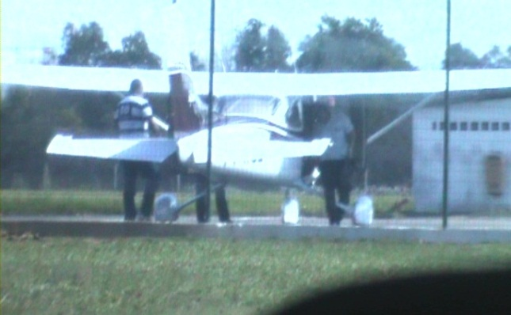
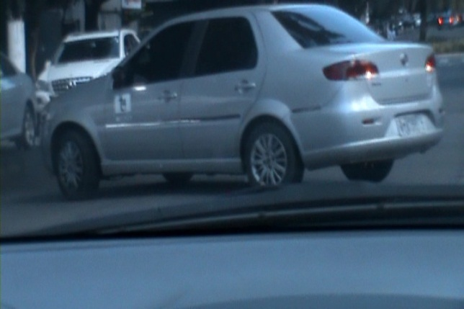
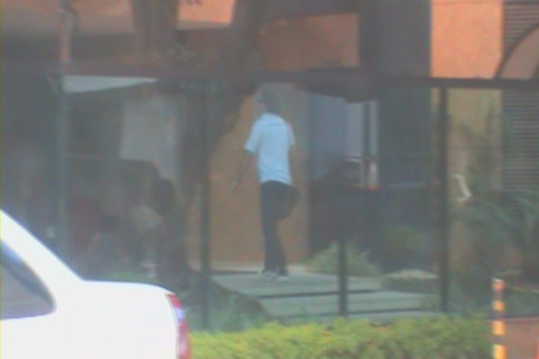
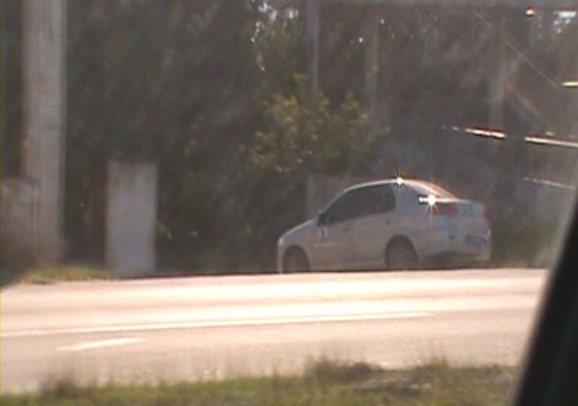
ESOPO/MG - Limits
27

Slide 28
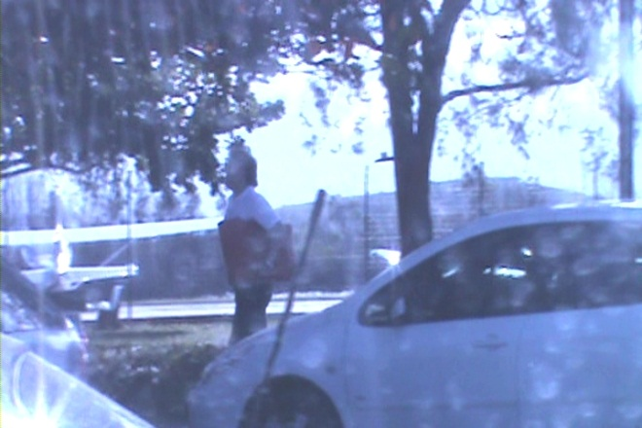
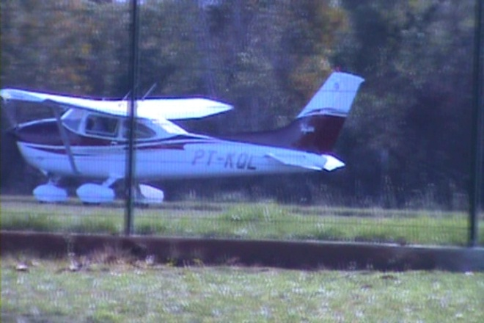
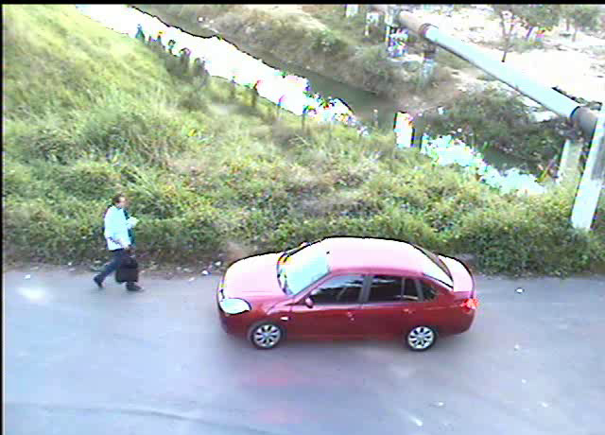
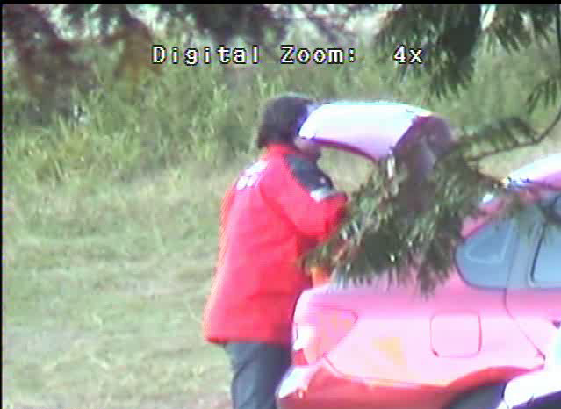
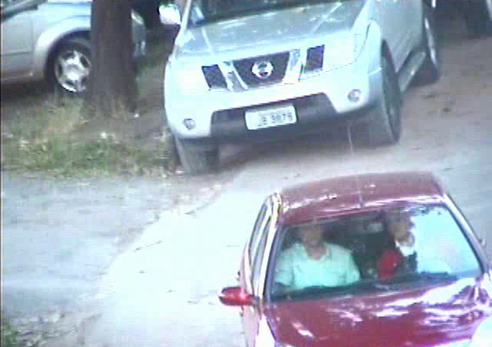
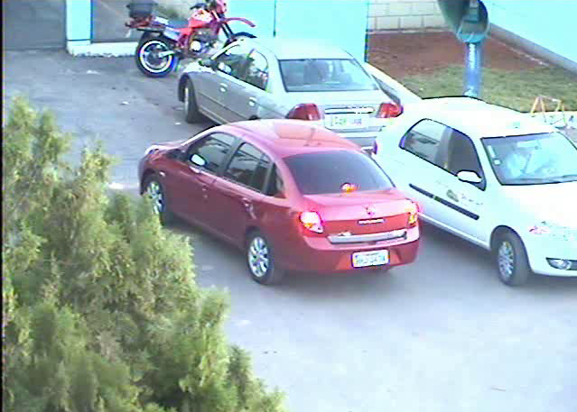
ESOPO/MG - Limits
28

Slide 29
SUFRÁGIO LIVRE (Free Suffrage) – The event that gave rise to the series
Background of legislation improvements – Decree 7507/2011
Municipality already investigated in another Police Operation
Beginning of the use of financial information extracted from the System for Transfer of Public Payments
Use of federal funds to finance candidates running for municipal representations (2008 election)
Limitation overcame with the breach of bank secrecy achieved at the 1st instance (electoral courts).
29

Slide 30
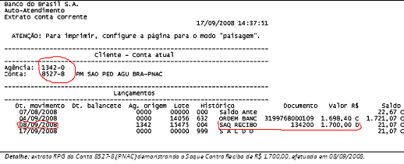
SUFRÁGIO LIVRE – The event that gave rise to the series
Bank statement – PNAC Program
30

Slide 31
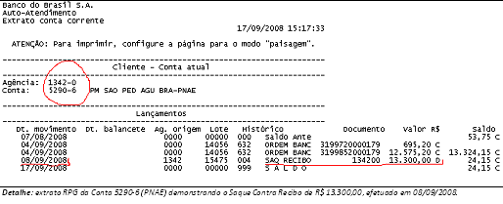
SUFRÁGIO LIVRE – The event that gave rise to the series
Bank statement – Food Scholarship Program
31

Slide 32
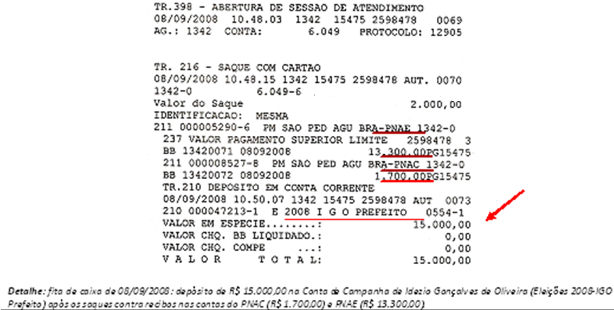
SUFRÁGIO LIVRE – The event that gave rise to the series
Recorded details of the banking activity
32

Slide 33
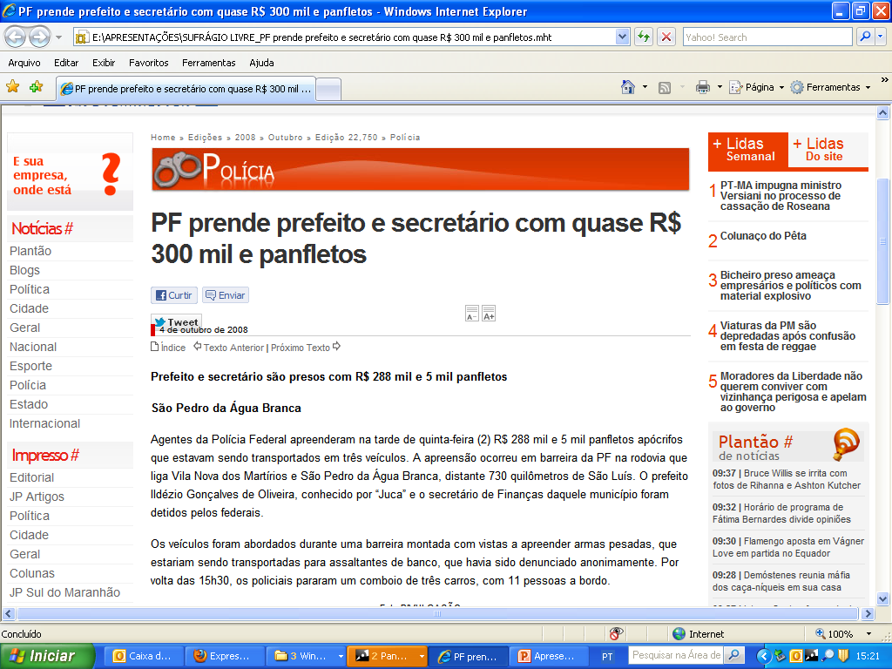
SUFRÁGIO LIVRE (FREE SUFFRAGE) – Press News
32

Slide 34
ORTHOPTERAS I and II
Background of legislation improvements – Decree 7507/2011
Use of Information Systems (BB RPG, SIAFI, TSE)
Focus of the analysis were the suspicious disbursement operations: cash withdrawals, check cash, transfers to other accounts of the municipality (gateway accounts)
Inversion of the normal order of the analyzes carried out so far: audit began monitoring the financial account, documentary analysis and site visit after breach of secrecy
Limitation overcame with the breach of bank secrecy (MPF and MPE) achieved at the 1st instance
33

Slide 35
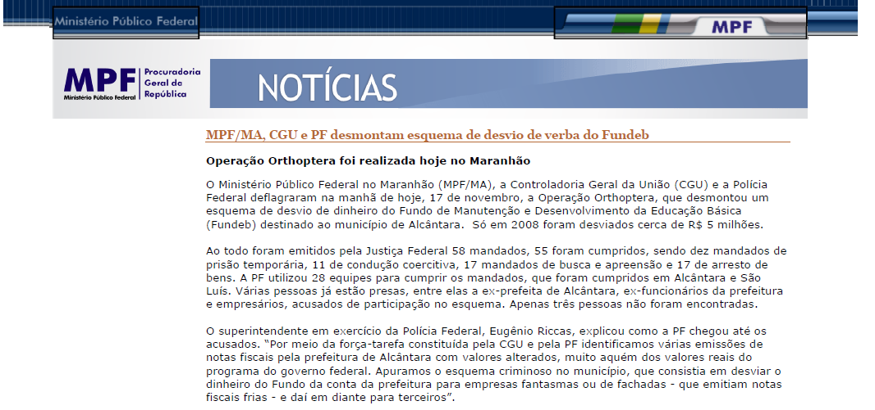
ORTHOPTERAS I and II - News
34

Slide 36
Challenges of the Internal Control when Fighting Against Corruption

Slide 37
Fighting against fraud and corruption requires an ongoing learning process and the constitution of centers of excellence
Special Action (Inspection) Teams – permanency and further development
Access to confidential information (guarded by third parties)
Enhancement and sharing of IT Tools

Slide 38
Thank you!
Roberto César de Oliveira Viégas
Head of the Regional Office at Minas Gerais
Office of the Comptroller General

