Slide 1
The Internal Audit Function in the Public Sector
Seeuws Katleen

Slide 2
Presentation Content
Internal Audit Standards
Definition of Internal Audit
Purpose of Internal Audit
Internal Audit Stakeholders
Content of Internal Audit Services
Key Apects for Adding Value
Centralized versus Decentralized Structure
Current Developments
Conclusions

Slide 3
International Audit Standards
Mandatory and strongly recommended guidance
- Definition
- International Standards
- Code of Ethics
Performance and Attribute Standards
(IPPF – Institute of Internal Auditors)

Slide 4
Definition of Internal Audit
Internal audit is an independent and objective assurance and consulting activity designed to add value and improve the organisation’s operations.
It helps the organisation in achieving its objectives by bringing a systematic, disciplined approach to evaluate and improve the effectiveness of the risk management, control and governance processes.
(IPPF – Institute of Internal Auditors)

Slide 5
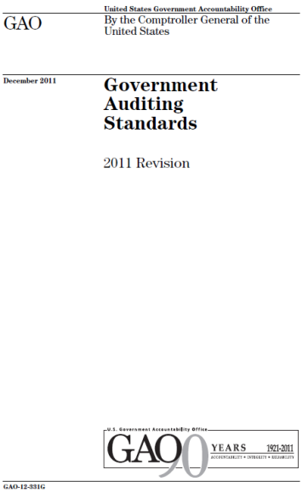
Purpose of Internal Audit
Independent
Objective
Accomplish objectives
Risk, control, governance
Systematic approach
Evaluation
Professional judgement
Competence
Quality Control
ADDED VALUE

Slide 6
Internal Audit Stakeholders
BOARD | MANAGEMENT | REGULATORS
Assurance | Advise | Assurance
Eyes and ears | Assurance | Information
Oversight | Insight | Insight and oversight
More profits | Better performance | Time gain

Slide 7
Content of Internal Audit Services
Assurance services→ Opinion or conclusion
Consultancy services → Advise
Opinion or advice on:
- Controls
- Risk management
- Governance

Slide 8
Key Aspects for Adding Value
Independence and objectivity
Relation with management
Control environment
Audituniverse and scope
Qualitiy assurance and methodology
Resources

Slide 9
Independence
Standards – legal framework - Auditcharter
Position within the organisation
Public access to reports
Recources
Auditplanning
Presence of an Audit Committee
Objectivity → auditors
Selection, evaluation and dismissal
Formation – certification
Ethical code

Slide 10
Relation with management
Confidentiality
Auditplanning considers management concerns
Reporting
Facilitates accountability

Slide 11
Audituniverse and scope
Limitations in legislative framework
Maturity level of internal control
Types of audits:
- Performance audit
- Compliance audit
- Financial audit
- Operational audit (incl. IT audit)
- System audit (financial and non financial)
- Due diligence audit
Crosscutting processes
Fraude investigations

Slide 12
Resources
Scarce recources, efficiency considerations
Staff
- Presence of qualified and specialized staff
- Mobility
- Rotation obligation
Outsourcing

Slide 13
Quality Assurance
Internal and external evaluations
Standards and Ethical Code
Efficiency and effectiveness of Internal Audit
Measure performance
Improve Internal Audit activities

Slide 14
Centralized versus Decentralized Structure
Strategic and political choice
(effectiveness versus efficiency)
Centralized or decentralized policy execution
Position close to the highest executive level

Slide 15
Attention areas
 | CENTRALIZED | DECENTRALIZED
Independence and objectivity |  | Consider Auditcommittee
Relation with management | Consider management concerns (auditgap)
Scope | Ensure knowlegde of operations and procedures | Ensure total coverage and avoid duplication of work
Resources |  | Consider efficieny
Qualitiy assurance and methodology |  | Consider evaluation by other departments

Slide 16
Current developments
New technologies
Comprehensive audit
More focus on risk management and governance
Use for strategic planning

Slide 17
Conclusions
Importance of the Standards
Focus on adding value
Adequate fulfillment of key aspects
Internal role as a business partner
Be aware of changing conditions

Slide 18
Thank you for your attention !
Any questions…

