Slide 1
Better Regulation: The European Commission Impact Assessment System Workshop on Regulatory Impact Analysis Carlos Oliveira EU Delegation in Brazil Carlos.Oliveira@eeas.Europa.eu

Slide 2
Content
Setting the scene:
What is better regulation?
The May 2015 Better Regulation Package: the new opportunities
Commission Impact Assessment system
A few supplementary points

Slide 3
What is Better Regulation?
Legislation/policy that delivers objectives at least cost
A common sense way of working throughout the policy cycle:
Evidence-based policy making that supports political decisions and delivers high quality initiatives;
Avoids unnecessary burdens for business/public authorities;
Ensures transparent participation of all stakeholders;
Initatives deliver as foreseen and remain fit for purpose.
Not deregulation but more efficient delivery of societal objectives.

Slide 4
A few examples
simpler financial reporting system for 5 million micro-companies: €6.3 billion savings (estimated)
registration fees under REACH chemicals legislation cut by up to 95% for SMEs
procurement costs cut by up to 20% thanks to new electronic procurement rules
new digital tachographs for lorry drivers increase safety and cut red tape: annual savings €400 million (estimated)

Slide 5
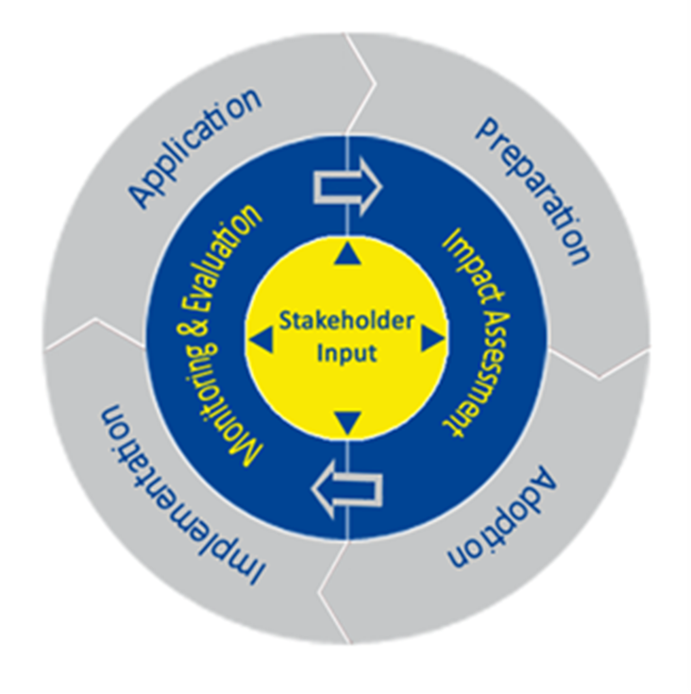
The Policy cycle
Commission
The Commission & Member States
Legislator
"Evaluate First" before proposing changes to existing legislation (New May 2015)

Slide 6
Better regulation package

Slide 7
May 2015
Feedback on Commission proposals
Public consultation in the context of all Impact Assessments and Evaluations
Regulatory Scrutiny Board
Impact Assessments and Evaluations
Integrated Better Regulation Guidelines
Impact Assessments on Substantial Amendments
Feedback on Roadmaps,Evaluation Roadmaps and Inception Impact Assessments
Feedback on draft delegated and Implementing Acts

Slide 8
Better Regulation Package: main elements
Focus on linking up better the steps of the entire policy cycle
Greater transparency
- more extensive feedback/public consultation;
- improved explanatory memorandum;
Better Tools
- integrated Better Regulation Guideline + Toolbox
- interinstitutional agreement Better Law making
Enhanced scrutiny in the Commission (new RSB)
Focus on implementation (Regulatory Fitness)

Slide 9
BR Guidelines & Toolbox
First ever integrated guidelines that cover the entire policy cycle
Planning and political validation of initiatives
Impact assessment
Stakeholder consultation
Monitoring and evaluation
Legal drafting
Implementation plans
Toolbox
59 separate short tools covering the entire policy cycle.
Operational "hands-on" guidance on the how/what/why.
Regular updates in light of experience

Slide 10
Impact assessment

Slide 11
An impact assessment needs to be carried out for all initiatives expected to have significant economic, social or environmental impacts. These can be:
Legislative proposals (especially those having an impact on regulation – e.g. electronic communications; data protection / privacy)
Non-legislative proposals (e.g. policy communications, white papers, action plans)
Implementing measures and delegated acts
Notes:
An Impact Assessment (IA) is required when the expected economic, environmental or social impacts of EU action are likely to be significant.
The benchmark criterion of "significant impacts" applies both to the macro- and the micro-level. This implies that IA is not only required for proposals expected to have far-reaching impacts on the economy or society as a whole, but also for initiatives likely to have a significant impact on a particular sector, societal group or geographical area.
Initiatives for which the need for an IA must be assessed⁵⁴
New legal acts
Revision of existing legal acts
Recasts of existing legal acts
Non-technical repeal of existing legal acts⁵⁵
Delegated acts (Art. 290 TFEU)
Implementation measures (Art. 291 TFEU)
Transposition of international agreement into EU law⁵⁶
White papers
Policy communications
Action Plans
Commission and Council Recommendations
Recommendations for the negotiation of international agreements.
Social partner agreements pursuant to Articles 154-155 TFEU⁵⁷.
Financial programmes (i.e. all basic acts for spending programmes and financial instruments)⁵⁸

Slide 12
Responsibilities & sharing tasks
Lead Commission service(s)
responsible for work and final IA report
Key role of IA support unit/function in DGs
Inter Service Groups:
Early coordination
Roadmap/Inception IA
Input (incl. co-drafting)
Consultation strategy/docs
Help with ToR
Review all the key elements of the IA and the policy initiative
Discuss full IA before sending to Board
external expertise
Work guided by

Slide 13
IA planning process
RegulatoryScrutiny
Inception IA

Slide 14
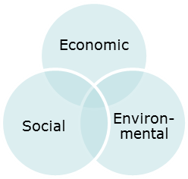
Commission Impact Assessment
A set of logical steps to help Commission services structure preparation of a proposal
Provide a balanced evidence base to support, not replace, political decision-making
Integrated approach: all benefits and costs; economic, social and environmental impacts
Wide scope: all initiatives with significant impacts, from policy defining proposals to implementing measures
Independent centralised quality control: the Regulatory Scrutiny Board
Transparency: publication of IAs and RSB opinions

Slide 15
Analytical steps of IA
1. Identify the problem
2. Assess need for EU-level intervention
3. Define the objectives
4. Develop policy options
5. Analyse the impacts of the options
6. Compare the options
7. Outline policy monitoring and evaluation
Notes:
1) The problem definition should:
Present (and substantiate) the scope/size of the problem
Identify the drivers
Identify who is affected and how
Start off the ‘thread’ of the analysis
Explain how the problem is expected to evolve
2) We need to justify why EU action is required - is the EU level the most appropriate level for action?
Subsidiarity analysis:
Why can the objectives of the proposed action not be achieved sufficiently by Member States? (Necessity Test)
Can objectives be better achieved by action at EU level? (test of EU Value Added)
3) The objectives should be:
Linked to the problem and give direction to options
Consistent with other existing policy objectives
Specific, measurable and realistic
4) Options
Always 'do nothing' (benchmark) + look at the possibility of doing less (i.e. simplification)
Focus on content not format (i.e. policy instrument)
Realistic
5 and 6) Analysis and comparison
3 categories of impacts: ec., social, env. + specific impacts (competitiveness, micros, territorial, fund. rights)
Focus on content not format (i.e. policy instrument)
Compared in terms of effectiveness, efficiency and coherence
6) Monitoring and evaluation => identifies indicator against to assess success of measures in attaining objectives

Slide 16
1. What is the problem and why is it a problem ?
Verify the existence of a problem;
Identify who is affected (individuals, enterprises or other actors);
Estimate the problem’s scale;
Analyse the causes and consequences of the problem;
Assess the problem likelihood to persist in the absence of (further) EU policy intervention.
A key input to this assessment should be relevant evaluations or fitness checks of existing policy frameworks as well as stakeholder feedback.
_{2. Why should the EU act ?}
Verify whether Member States alone could resolve the problem sufficiently;
Verify whether the EU has the competence to act (i.e. legal basis) and would be best placed to do so (i.e. subsidiarity test).

Slide 17
3. What should be achieved ?
The Impact Assessment should set out what EU policy should achieve;
The objectives of policy action should be clearly identified, including the level of policy ambition and the criteria against which alternative policy options would be compared and the success of any initiative assessed.
4. What are the various options to achieve the objectives ?
Different options should be identified and screened:
The option of changing nothing (‘’baseline scenario’’)
The option of improving implementation and enforcement of existing legislation
Options to take account of new technological developments
_{Alternative policy approaches}
_{Alternative policy instruments}
_{Alternative scope}
At the end of the process, the most relevant alternative policy options should have been identified for further examination in the impact analysis stage.

Slide 18
5. What are the impacts of the different policy options and who will be affected ?
Identify all potential impacts (economic, social and environmental) of the options.
Select the significant impacts.
Assess the most significant impacts.
At the end of this process, policy-makers should know to what extend different policy options would meet their objectives, with what benefits, at what costs, with what implications for the different stakeholders, and at what risk of unintended consequences.
6. How do the options compare ?
Compare the different options with regard to their effectiveness, efficiency and coherence, as well as their compliance with the proportionality principle.
At the end of this process, the IA should present the relevant information for policy-makers to make a choice and, where appropriate, suggest a preferred option.

Slide 19
_{7. How would actual impacts} _{be monitored and evaluated?}
The IA should identify monitoring and evaluation arrangements to track whether the policy measure actually delivers the intended results;
At the end of this process, policy makers should know how the policy will be monitored and evaluated, allowing for future policy-adjustments whenever needed.
Mandatory annexes
Annex 1: Procedural information
Annex 2: Stakeholder consultation
Annex 3: Who is affected by the initiative and how
Annex 4: Analytical models used in preparing the impact assessment

Slide 20
An Example: Electronic Communications (1/6)
Context and problem statement
Goals: promoting competition, single market and consumers protection
Current situation: Effectiveness, Efficiency, EU added value, Coherence
Problem
low coverage and take-up of broadband; technological changes; redundancy
Revenues of the sector and investments; spectrum management; redesign of sector and market actors; bundled offers and consumer protection
How would the problem evolve all things being equal?

Slide 21
An Example: Electronic Communications (2/6)
2. Rationale for action
Why should the EU act? Broadband => 5G, Cloud, IoT, big data, digitisation of economy
Does it have a mandate? Competencies according to the treaties
EU vs Member States? NRAs vs BEREC
What is the EU added value? Single market efficiency gains, spectrum management

Slide 22
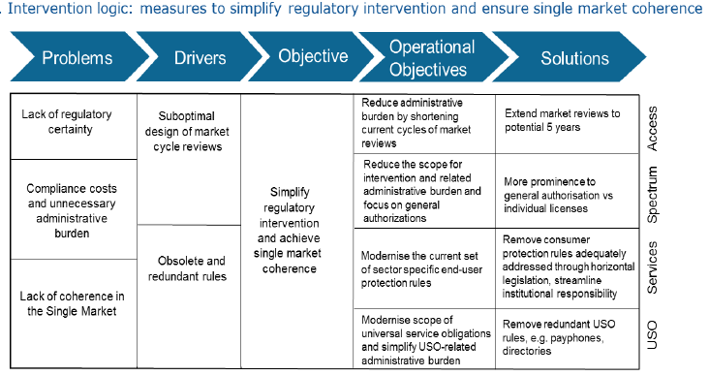
An Example: Electronic Communications (3/6)
3. What should be achieved: specific objectives, synergies and trade-offs
Ubiquitous very high capacity connectivity in the single market
Competition and User Choice
Simplification of regulatory intervention and market coherence

Slide 23
An Example: Electronic Communications (4/6)
4. Policy options and 5. Impacts (economic - efficiency, social, environmental; stakeholders)
...1 Baseline scenario: no action
...2 Continuity and simplification
...3 Regulation on high quality connectivity
...4 Reduction of sector specific regulation

Slide 24
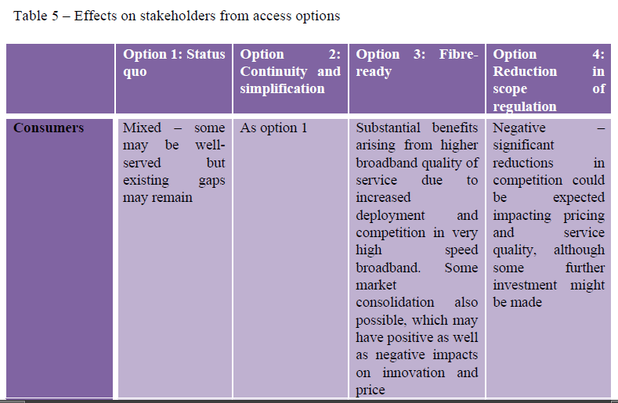
An Example: Electronic Communications (5/6)
6. How the options compare

Slide 25
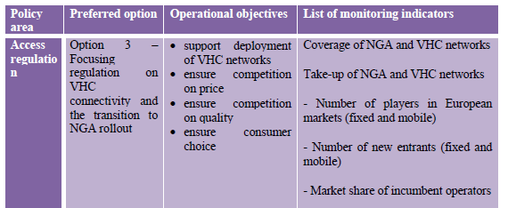
An Example: Electronic Communications (6/6)
7. Monitoring mechanisms for the preferred option

Slide 26
Unprecedented feedback opportunities
When?
Roadmap/Inception IA
Evaluation Roadmap
Draft implementing rules
Commission proposal and accompanying impact assessment
REFIT Platform
How?
Posted for feedback
Posted for feedback
Posted for 4 weeks
Posted for feedback post adoption 8 weeks
« Lighten the Load »

Slide 27
BR Toolbox
Selection of tools:
Evidence base
Subsidiarity & proportionality
Identifying problems
Policy instruments
Identifying Impacts
SME test, competitiveness
Resource efficiency
Digital and innovation
Implementation, transposition
Monitoring and evaluation
How to do evaluations
How to consult stakeholders
Methods and models (costs and benefits)

Slide 28
A few statistics….
295 roadmaps/inception impact assessments published
274 contributions received (at end of October).
128 Commission proposals published since 1 July 2015
28 046 contributions but 27 680 on 1 proposal (at end of October)
56 draft delegated/implementing acts published;
632 contributions (at end of October)
189 public consultations published in 2015-2016
on average about 440 responses per consultation; the EU population is 500 million!
About 25% of consultations published in all languages
Average length of public consultations: 13 weeks

Slide 29
More information
Commission implementing better regulation package progressively and will continuously update the better regulation tools in light of practical experience – 1st update of Toolbox later this year.
Europa: http://ec.europa.eu/smart-regulation/index_en.htm
Juncker Commission priorities site: https://ec.europa.eu/priorities/democratic-change_en
Contribute to policy making https://ec.europa.eu/info/law/contribute-law-making_en
Impact assessment

Slide 30
background

