Slide 1
Regulatory Impact Analysis (RIA):
Challenges and Opportunities for Effective Implementation in Brazil
Will Creswell
Regulatory Delivery

Slide 2
Regulatory Delivery
Directorate within the Department for Business, Energy and Industrial Strategy (BEIS)
Ensure that regulation is effectively delivered in ways that reduce burdens on business, save public money and properly protect citizens and communities.
Work with overseas governments to develop regulatory environments to create the conditions for growth, stability and international trade.

Slide 3
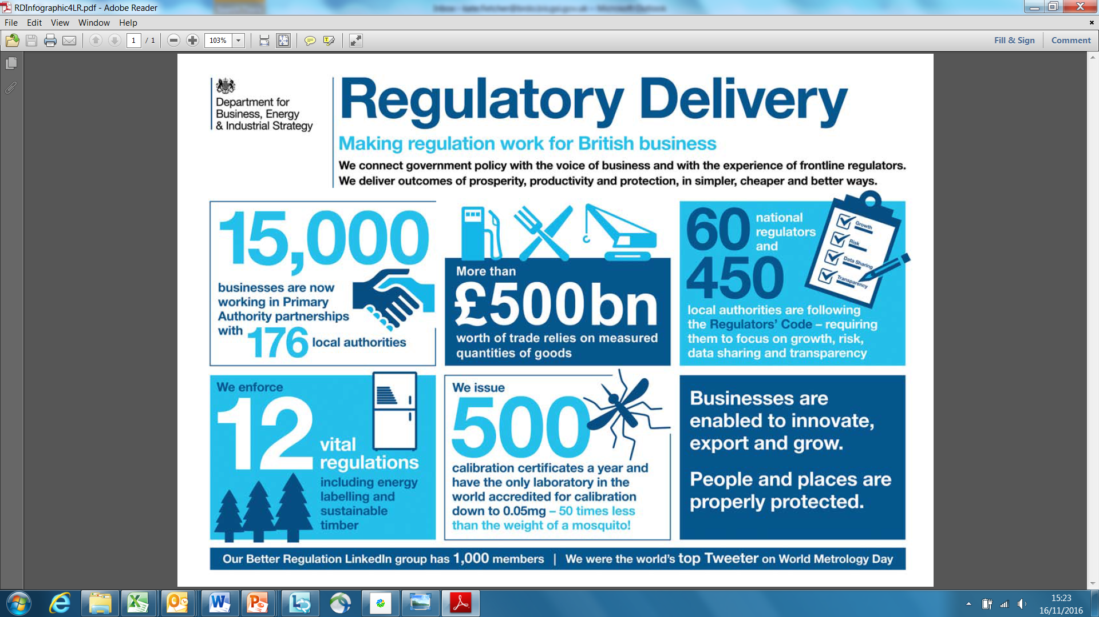

Slide 4


UK Government’s commitment to business
A strong economy
The best place in Europe to innovate, set up and expand a business.
Support British businesses by:
boosting competitiveness
cutting red tape
growing apprenticeships
opening up new export markets
boosting local growth
Notes:
Last parliament – estimated regulatory costs for businesses reduced by £10 billion.
In the Conservative 2015 Manifesto, there was a commitment to reduce regulatory costs for business by a further £10 billion between 2015 and 2020. Stretching target – gone after the low hanging fruit,

Slide 5

An economy that works for all
“From dynamic start-ups to established family firms, our small and medium sized businesses are the backbone of our country. I want to build an economy that works for all, and that means working with, and listening to, smaller firms. The priorities I have set: a more productive, skilled workforce, an economy balanced across the UK and open to new opportunities, can only be achieved if we listen to these businesses.”
Theresa May
UK Prime Minister
5

Slide 6

Businesses on Regulation
Burdens, red tape, barriers to growth and success
But…
Private sector development is driver for economic growth
Notes:
Businesses complain about excessive red tape.
2014 business perceptions survey, found that 51% of businesses saw the level of regulation in the UK as an obstacle to business success.
If businesses incur significant costs in complying with regulations. This can act as a barrier to competition in markets and reduce productivity.

Slide 7

What is Regulatory Impact Assessment?
So...... What is RIA and how do I contribute to business growth by producing one?
Is it just a?
Notes:
It is often seen as form filling exercise - viewed as either a bureaucratic exercise or a post-hoc rationalisation of policy decisions.
The form is only where we record our findings it is how we present it, common misconception.

Slide 8
Regulatory Impact Assessments
An Impact Assessment is both:
  A continuous process to help think through the reasons for government intervention; and
  A tool to be used to help ensure that policy is evidence-based
It summarises:
  The rationale for Government intervention
  The policy options considered
  The expected costs and benefits to society
Notes:
Support ministerial decision making and the ability to learn from its experience of implementing regulation

Slide 9
When are Impact Assessments required?
Impact Assessments are generally required for all UK Government interventions of a “regulatory nature” that affect the private sector, civil society organisations and public services. They apply regardless of whether the regulation originates from a domestic or international source

Slide 10
The RIA Process in the UK
Completed by Government Department policy leads with support of Departmental Better Regulation Units
Final impact assessment must be signed off by Departmental Minister and Permanent Secretary.
Has to be scrutinised by Regulatory Policy Committee and assessed as ‘Fit for purpose’ before proposals can proceed to the Cabinet Reducing Regulation Committee.
Red and amber rated assessments have to receive further work and be resubmitted for RPC approval
Issued at same time as consultations and when final regulations and Acts are published
Notes:
RPC – Set up in 2009 and in 2012 became an advisory non- departmental public body, sponsored by BEIS.
Committee of 8 members, supported by a Secretariat (civil servants) - committee Includes economists, business reps and a civil society rep.
Scrutinises and validates departments’ estimates of costs and benefits to business.
Provides independent scrutiny of the quality of the analysis . Does not comment on public policy.
Aims to support departments improve the quality and consistency of apprasials
Ensure that there is a sound evidence base for regulatory change
The RPC will issue an opinion within 30 days.
Has three ratings:
Red – IA not fit for purpose – major concerns over analysis which need to be addressed
Amber – is fit for purpose – but there are some areas of concern that should be addressed before a final decision is made
Green – fit for purpose – may be some areas that could be improved.
Reducing Regulation Committee – cabinet committee – chaired by SOS for BEIS, Minister for Cabinet Office – deputy chair.

Slide 11
Sign off Requirements for RIAs
It is the responsibility of Departments, in the first instance, to ensure the quality of analysis of their own impact assessments.
Chief Economists should sign off impact assessments for the robustness and accuracy of the costs, benefits and impact analysis. To facilitate this, Departments are expected to set up robust Departmental processes. These could include Ministerial challenge panels, peer group review, consultation with Chief Economists.
Minister responsible for the policy (or the Chief Executive of non Departmental public bodies and agencies) is also required to sign off the impact assessment. The appropriate ministerial declarations can be found in the IA Template

Slide 12
Other scrutiny of RIAs
Ministers are required to sign Impact Assessments as being true statements for which they are accountable to parliament.
Oral, Written parliamentary questions on Impact assessments increasingly prevalent.
Bill Committees will scrutinise impact assessments during the legislative process.
Select Committees, the Public Accounts Committee and also the National Audit Office will comment on the accuracy of Impact assessments.
Impact assessments are increasingly important as a source of information for post implementation reviews

Slide 13
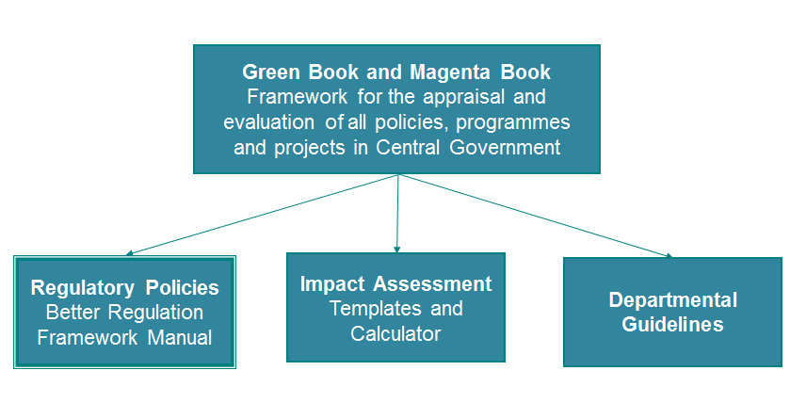
RIA Guidance in the UK

Slide 14
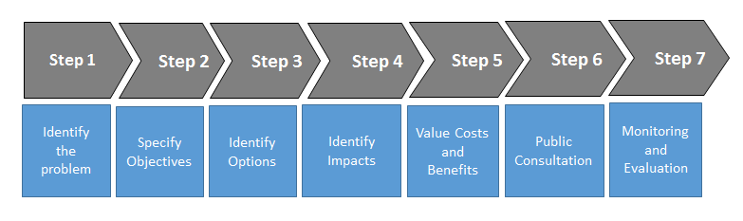
The RIA Process in the UK
Notes:
.

Slide 15
The RIA Process in the UK
Step 1
Confirm there is a problem
If there is a problem, identify it clearly
Consult relevant experts (e.g. Economists, academics)
Assess the scale of the problem
Consider who is best placed to manage / resolve the problem (e.g. Government, the markets, the Trades Unions)
Identify the problem
Notes:
A RIA starts by verifying the existence of a problem, identifying who is affected, estimating the problem's scale, analysing its causes and consequences, and assessing its likelihood to persist in the absence of Government intervention.
The answer to this question should give policy-makers the information needed to decide whether there is a problem for which a policy response may be warranted.
A clear definition of the problem is vital to ensure the subsequent steps of the RIA process will result in the best option being identified

Slide 16

What is the problem?
..... by assembling all the relevant information that we have. We need to identify the gaps in our understanding.
Being precise and specific in explaining the problem usually leads to better results
Notes:
You may not want to use this slide – it just provides a visual, so is not absolutely necessary?

Slide 17
The RIA Process in the UK
Step 2
Identify clear policy objectives
Check that policy objectives are achievable
Consider who is best placed to manage / resolve the problem (e.g. Government, the markets, the Unions)
Ensure targets are SMART
Specify Objectives
Notes:
Objectives link the analysis of the problem to the options for the policy response. They set the level of policy ambition, determine the criteria for how policy options can be compared and determine how the achievements of the policy can be monitored and evaluated. Objectives can be set at different levels and at different times.
Policies are designed to achieve goals or solve problems.
Each policy is directed at an objective – the destination
The goal: increase economic activity the objectives increase the number of small businesses, to increase access to credit, and to improve hiring practices.
Goal improve the transport system an objective reduce journey times between specific cities.
Goal improve the education system objective increasing the percentage of schools at which children are educated for the entire school day.
For example, when the problem is lack of knowledge about the law requiring seatbelt use, an objective would be to increase knowledge and compliance with the law about seatbelt use.

Slide 18
The RIA Process in the UK
Step 3
Identifying policy options is an iterative process.
Consider as many realistic alternatives as possible and then narrow them down to the most relevant ones for further analysis.
Identify Options
Notes:
The problem has been identified, objectives have been set our objectives, the destination,where we want to get to, but when or other measures.
Now we must identify options – or how to get to our destination. Rather like a journey some will be more expensive than others, or we could just decide to stay home and do nothing.
Common challenges/pitfalls at this stage:
No consultation – meaningful engagement is necessary to create a full range of options
Consider alternatives to regulation – the mindset of many regulators (and politicians) is to regulate rather than consider alternatives to regulation. These options can often be cheaper and have better results.
Who will enforce the policy? Do they have the necessary resources and expertise?
Engagement and data collection
The options identified at this stage, are refined through development, and consultation throughout the policy making process.

Slide 19
Identify Options
Do nothing
Modify the existing policy
Regulate behaviour through law
Change the approach to Implementation
Information and education
Notes:
. As a matter of course, in the UK we always include a “do nothing” option
As a matter of course, in the UK we always include a “do nothing” option

Slide 20

Move from a long list to a short list of Options
Identify Options

Slide 21
The RIA Process in the UK
Step 4
Identify the impacts by issue type (economic ; social; environmental, etc)
Identify the groups affected
Detail how the proposals might affect small and medium sized enterprises
Identify Impacts
Notes:
To identify impacts we explore who will be affected and in what ways by the proposed policy change.
Types of impacts:
Economic (business, competition)
Social (health, human rights, equalities)
Environment (carbon budgets, climate change)
it is important to detail the anticipated consequences of the policy proposals and to consider small businesses, who tend to be disproportionately affected by the burden of complying with Government rules and regulations

Slide 22
The RIA Process in the UK
Step 5
Identify the groups affected
Monetise costs and benefits as far as possible
Clearly highlight direct costs to business
Rigorously assess non-monetised costs and benefits
Explore risks and sensitivities
Use cost benefit or cost effectiveness analysis to select the best option
Value Costs and Benefits
Notes:
Once a set of policy options is selected, a robust assessment should be carried out of their economic, social and environmental impacts and of who will be affected.
At the end of this process, policy-makers should know to what extent different policy options would meet their objectives, with what benefits, at what cost, with what implications for different stakeholders, and at what risk of unintended consequences.
Often here that there is no data, there is always data, the skill is to find it and make a decision on how to use it. E.g. tobacco packaging RIA used data from Australia

Slide 23
Benefits
Reduced crime
Improved Health
Costs
Operation & Maintenance
Construction materials
Equipment
Staff
Increased
Productivity
Impacts should be to all members of society, financial and non-financial
Notes:
First stage of a social CBA is to identify all of the relevant costs and benefits
Not just those falling on the direct users of the project but to everyone who is directly or indirectly affected
Some of these will be financial (e.g. cost of employing staff or purchasing machinery) others will be non-financial (e.g. improved health or reduced risk of accident)
------------
Relevant costs and benefits are those that can be affected by the decision at hand
Should be considered over the useful lifetime of the asset

Slide 24

Value costs and benefits
Quantifying impacts
Quantify impacts
How many
staff
will be needed?
How many cancer
patients
will be treated?
What will be the
take-up rate of training
places offered?
What % of children
will achieve 5+ GCSEs?
How many hectares
of land will be
freed of pollution?

Slide 25
Value costs and benefits
Costs to business of regulation
Notes:
Utilisation of the SCM provides consistency across government and allows measurement of the level of administrative burdens introduced
Current (post Implementation of One in, Two out) UK Impact Assessments require consideration of changes in Policy costs and Administrative burdens when assessing the impacts of a regulation on business. Business as usual costs can be considered but should be displayed separately. One-off (transitional) and recurring costs should be identified separately. (section highlighted in light blue)

Slide 26
Different approaches: Standard cost model
A widely used methodology for estimating administrative costs of regulation

Slide 27
The RIA Process in the UK
Step 6
Identify those consulted with and how it was conducted
Monetise costs and benefits as far as possible
Clearly highlight direct costs to business
What were the results of this engagement and how was the input of stakeholders taken into account
Use cost benefit or cost effectiveness analysis to select the best option
Public Consultation
Notes:
Consultation is a structured way to ask for relevant information from people who would be affected (directly or indirectly) by the measure under examination.
Effort to consult should be proportionate to the scale of the problem being considered
Clear objectives should be set
Actively manage timing and timeliness – minimum period for public consultation? Consultation should be meaningful process not just a tick box. Need enough time to undertake all steps of the process and consult with stakeholders and sufficient time to consider that information and adapt
Sufficient budget for the consultation process
Identification of stakeholders - Adapt and mix consultation mechanisms according to the issue being considered and range of stakeholders
Consultation should happen at all stages of policy making process, wider and early engagement with all stakeholders during the policy making process has been proven to lead to better policy outcomes.

Slide 28
Why is consultation important?
Strengthens the information basis of the regulatory process
  Helps to identify actual consequences and impacts
  Seeks active engagement in discussing data and other information
Increases citizens participation
  Highlights potential problems and opposition
  Raises awareness of future regulation
  Increases legitimacy of final proposals
  Builds trust and addresses concerns about favourable treatment of certain stakeholders
  Creates ownership and boosts compliance

Slide 29
Why is consultation important?
3. Raises the transparency of Government decision-making
  Provides clear decision making processes
  Communicates to citizens why decision has been made
4. Reduces the risk of unintended consequences
5. Improves implementation
  Testing likelihood of whether the proposals work on the ground

Slide 30
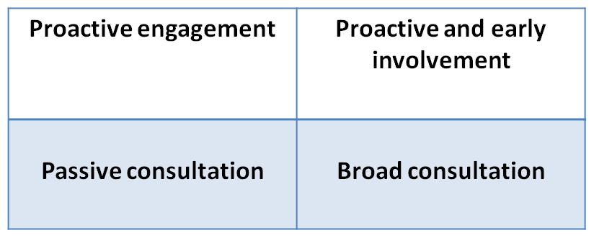
Mapping Stakeholders: Stakeholder Quadrant
Importance to RIA outcomes:
HIGH
LOW
HIGH
Influence on outcomes

Slide 31
Mix of mechanisms
Many
Survey
PR/Social media
Notice and comment
People
Public meetings & panels
Semi-structured interview
Focus Groups
Few
Low
Complexity / cost
High
Notes:
Broad
Written consultations
Calls for evidence and invitation to comment
Public hearings
Twitter
Public meetings
Targeted
Identified stakeholder and representative groups
Focus groups and test panels
Conference events
Practitioner panels and industry/government panels
Questionnaires and surveys

Slide 32
The appropriate consultation tool(s)
The selection of a consultation tools depends on:
  Who and when
  Time constraints
  Resources available (time and costs)
  Benefit/Cost balance
  Reliability and consistency of the expected results
  Exhaustiveness and utility of RIA aims

Slide 33
Example of written consultation – template for consultees’
Notes:
It is useful to use a mixture of questioning techniques to gain views – perfectly ok to use open and closed questions. For example, where you have consulted previously on an issue and are wishing to confirm the position. In this instance – this was the second public consultation & we wished to finally check stakeholders views – partly because one stakeholder group was very vocal in their wish to remove/exclude specific Acts/regulatory areas from the scheme.

Slide 34
The RIA Process in the UK
Step 7
Aim is to establish whether and to what extent, the Government action:
Has achieved its original objectives?
Has objectives which are still valid?
Is still required and remains the best option for achieving those objectives?
Can be improved to reduce the burden on business and its overall costs?
Monitoring and Evaluation
Notes:
This is more challenging. Temptation (pressure) to look forward and focus on new policy changes on the horizon.
UK uses Magenta Book
Set date for evaluation and make plan for evaluation during polciy develop,emt.
Identify baseline, and information that will need to be gathered and by who.
Talk about UK PIR process – this is something we have found particuarly challenging in the UK.
In 2016 UK only completed 28 PIRs – should have much more – how do we get departments to do more?
Statutory review clauses in legislation
Departments need to plan for PIRs from the beginning of the RIA process

Slide 35
Evaluation
Objectives set at Step 2 are crucial to considering and measuring success. Plan your evaluation
Establish what data collection is required
Identify what mechanisms can be used to produce & gather data throughout implementation phase – e.g. management data
Evaluate policy
Consult with stakeholders about policy effectiveness
Notes:
This is more challenging. Temptation (pressure) to look forward and focus on new policy changes on the horizon.
UK uses Magenta Book
Talk about UK PIR process, PIRs are a form of evaluation to check if the policy is having the intended effects, this is something we have found particularly challenging in the UK.
In 2016 UK only completed 28 PIRs – should have much more – how do we get departments to do more?
Statutory (sunset) review clauses in legislation
Departments need to plan for PIRs from the beginning of the RIA process - Evaluation cannot be done properly if it is not planned for and the required information is not gathered.
Set date for evaluation and make plan for evaluation during policy development.
Identify baseline, and information that will need to be gathered and by who.

Slide 36
“Consultation was the most quoted type of evidence. We’ve found that impact assessments which used a greater range of evidence sources tended to achieve better quality ratings.” (NAO)
Quality RIA - How the UK got there
36

Slide 37
Quality RIA - How the UK got there
The quality of Impact Assessments
“The new IA process has helped to improve the standard of IAs. The introduction of a new template, guidance and training has improved the clarity of presentation in IAs. As a result, there is greater consistency in providing the requested information, for example on the proposed timing of post-implementation review. There was also a greater incidence of quantification: the proportion of IAs which quantified costs increased from 56 per cent in 2006 to 67 per cent in 2008, and the proportion that quantified benefits increased from 40 per cent to 60 per cent.”
37

Slide 38
Regulatory Policy Committee Recommendations
1: Don’t presume regulation is the answer
2: Take time and effort to consider all the options
3: Make sure you have substantive evidence
4: Produce reliable estimates of costs and benefits
5: Assess non-monetary impacts thoroughly
6: Explain and present results clearly
7: Understand the real cost to business of regulation
38

Slide 39
Common Challenges
Problem identification
“Proportionate analysis”
Quantification
Risk assessment
Consultation and data
Considering alternatives
39
Notes:
Resource or time pressures within departments: feedback from departments suggests that, with departmental resources under increasing pressure, fewer resources are available to support the development of high quality impact assessments. This is compounded by a number of submissions produced under significant time constraints.
Major political changes and impacts on policy directions: the forming of a new Government in 2015, and the subsequent changes in the political landscape during 2016, has, in some cases, resulted in changes in policy direction, or has introduced new timetable pressures and requirements

Slide 40
Lessons learnt
Scope of application / selection of proposals
Appropriate quality control and oversight mechanisms
Presentation / Communication
Integrate up-stream – use early in decision-making
Integrate down-stream – factor in implementation and monitoring
Regular training
Publication of impact assessment and RPC responses and statistics on departmental performance
40
Notes:
Most agree with the rationale of undertaking a RIA
The challenge is how to make the most use of this discipline:
ensure that it is done to a high standard
avoid an obsession with process and box ticking - not just a bureaucratic exercise or a post-hoc rationalisation of policy decisions
develop the estimates of costs and benefits that are the best available at the time
equip the political decision makers to take decisions on the basis of such evidence

Slide 41
Regulatory Impact Analysis (RIA):
Challenges and Opportunities for Effective Implementation in Brazil
Will Creswell
Regulatory Delivery

